Slide 1
Algorithmic Approaches to Enhance Test Case Selection: A Dynamic Programming Primer
B. Venkata Lahari(BL.EN.U4CSE21042)
B. Dhathri (BL.EN.U4CSE21043)
G. Nithin (BL.EN.U4CSE21053)

Slide 2
Abstract
In software development, ensuring higher product quality involves extensive testing, requiring the execution of numerous test cases. However, time constraints often compel the selection of a subset of test cases. In response, a dynamic programming-based test case selection algorithm is proposed. This algorithm optimizes the choice of test cases by strategically considering factors such as coverage, critical functionality, and historical failure rates. By employing dynamic programming principles, the algorithm efficiently navigates the trade-off between exhaustive testing and time limitations, contributing to enhanced product quality within resource constraints.

Slide 3
Introduction
We select the test case which has minimum time and maximum cost as all test cases cannot be executed because of time limitation.
Selecting the correct test cases is important as testcases helps us to detect errors in our program.

Slide 4
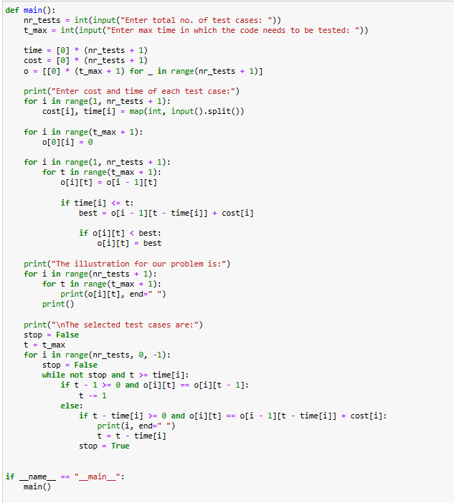
Python code

Slide 5
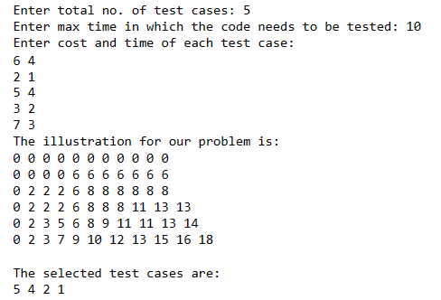
Output

Slide 6
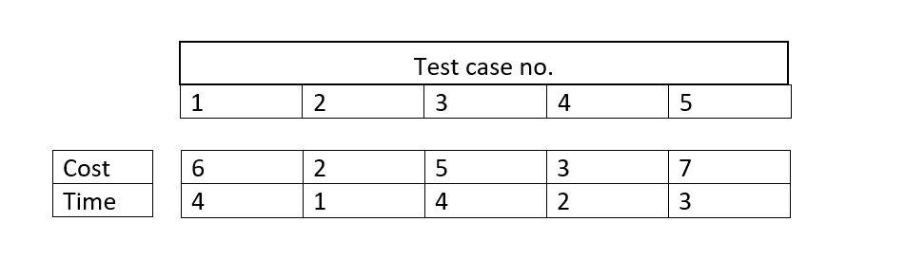
Problem statement:
→Assume there are 5 test cases and their costs and time are given.
→Maximum time in which the code needs to be tested is 10.
→But when we add the time in our 5 test cases the time is 14.
→So ,when we have to select the testcases which when combined should give time less . than or equal to 10 and also has maximum cost.

Slide 7

We have declared a 2-dimensional matrix o[nrTest+1][tMax+1] and array time[nrTest+1] and cost[nrTest+1]

Slide 8
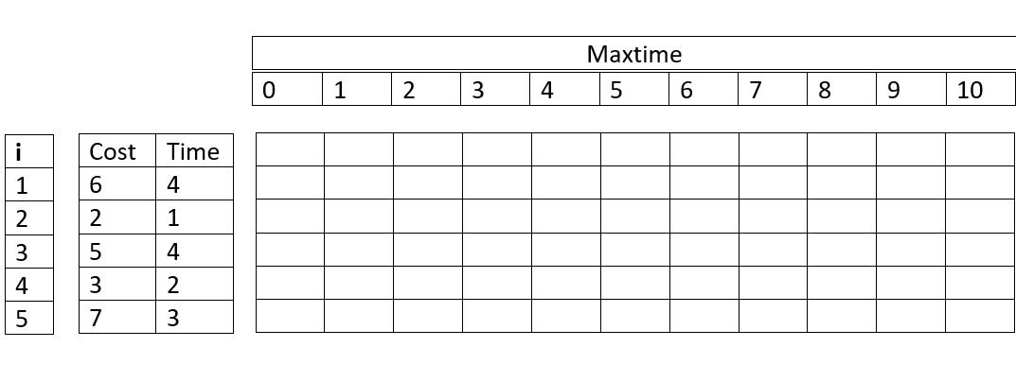

Slide 9

We initialize all the elements
of first row to 0 (zero)

Slide 10
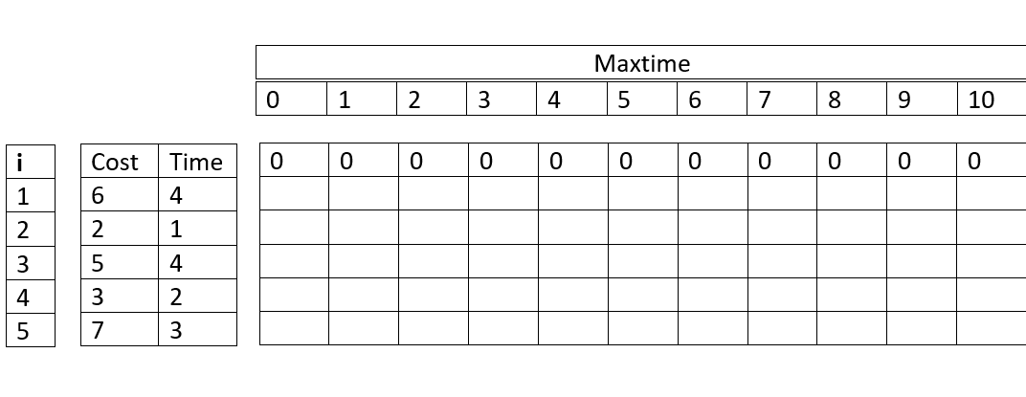

Slide 11
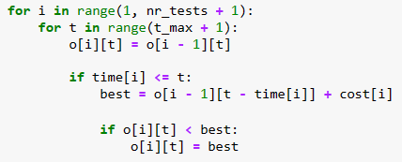
We have taken a nested loop where i represents the nrTest(row) and t represents the tMax(column)
When we start the iteration, i=1 and t=0,
o[i][t] = o[i-1][t]
i.e o[1][0] = o[0][0]
o[1][0] = 0

Slide 12
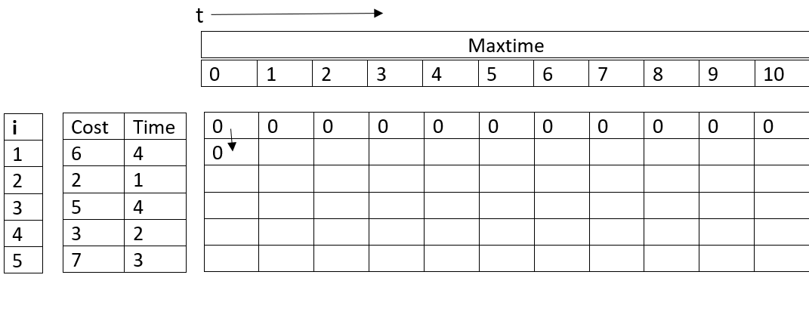

Slide 13
Next, we check the condition
time[i]<=t
As we are checking for first iteration, i=1 and t=0,
time[1]<=0
4<=0
Which is not true so the conditional statements does
not get executed.
Similarly for t=1,2,3 the values for o[i][t] i.e o[i][1], o[i][2],
o[i][3]=0
As conditional statement time[i]<=4 won’t satisfy

Slide 14
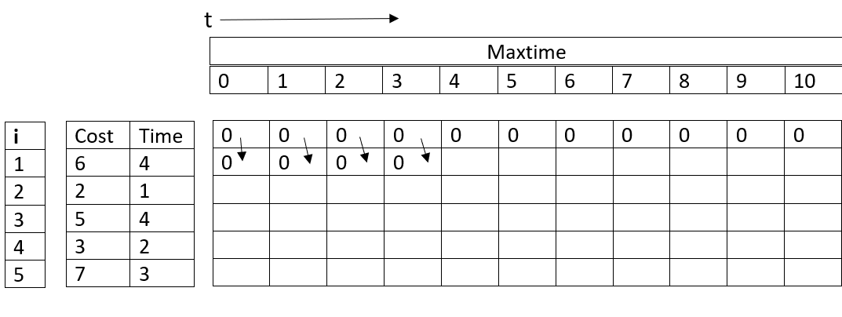

Slide 15
For i=1 and t=4,
o[i][t] = o[i-1][t]
i.e o[1][4] = o[0][4]
o[1][4] = 0
Next, the if condition, time[i]<=t
time[1]<=t
4<=4
Which is true, So
Best=o[i-1][t-time[i]] + cost[i]
Best=o[1-1][4-4] + cost[1]
Best=o[0][0] + 6
Best=6
The next if condition o[i][t]<best
o[1][4]<best
The condition is true So, The statement
o[i][t]=best is executed
o[1][4]=6

Slide 16
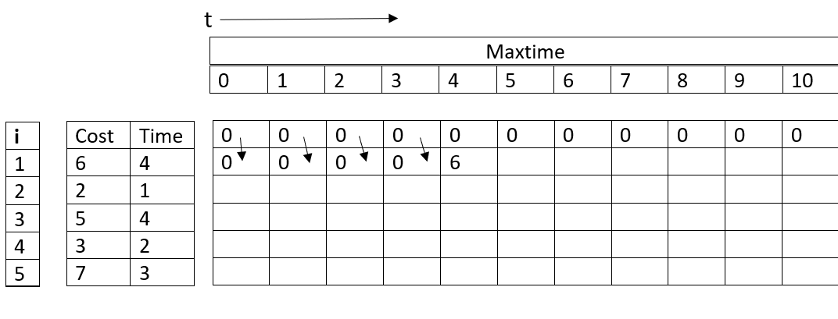

Slide 17
Similarly, all the values in the table are filled

Slide 18
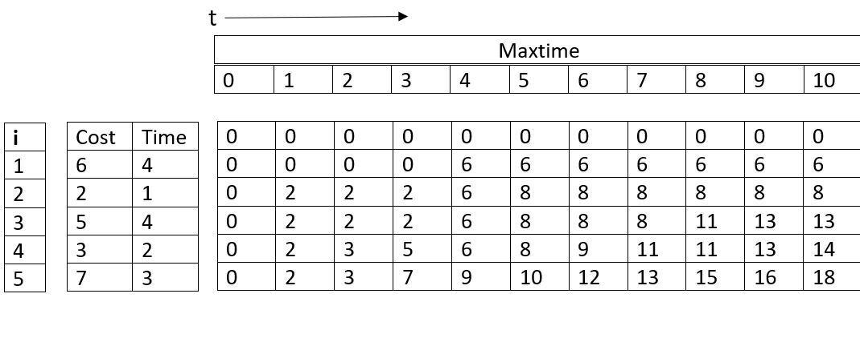

Slide 19
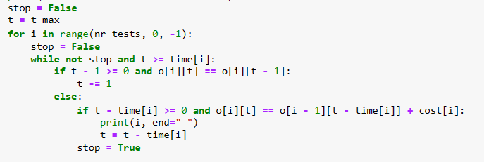
t is updated to
t=t-time[i]
t=10-time[5]
t=10-3
t=7

Slide 20
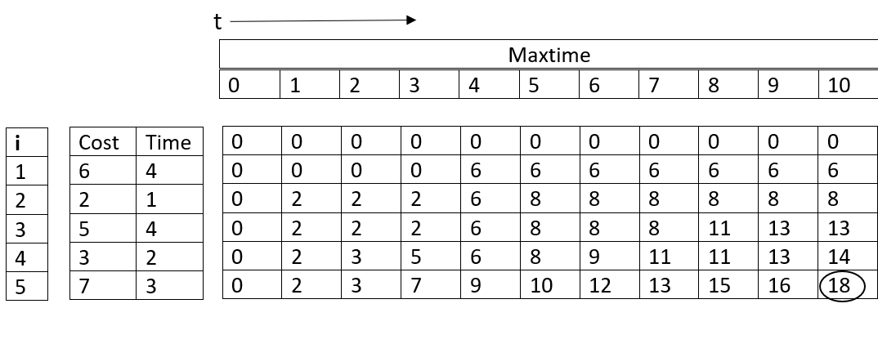

Slide 21
t is updated to
t=t-time[i]
t=7-2
t=5

Slide 22
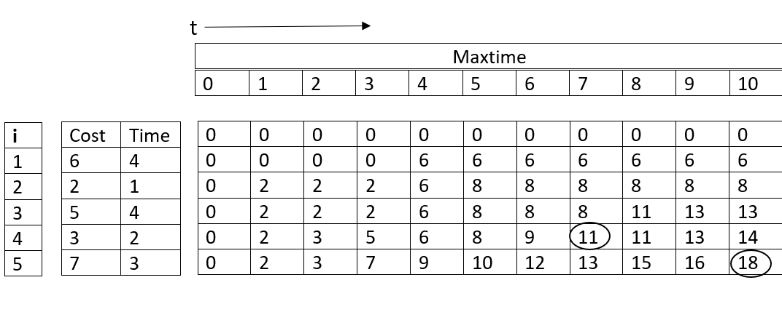

Slide 25
t value is updated to
t=t-time[i]
t=5-time[2]
t=4

Slide 26
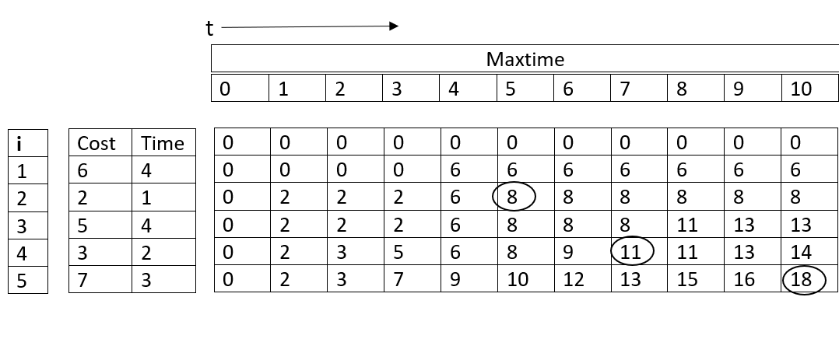

Slide 28
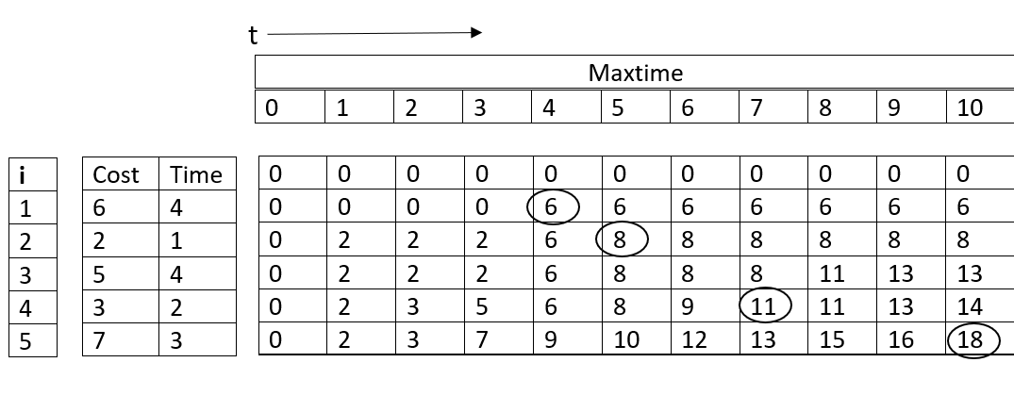

Slide 29
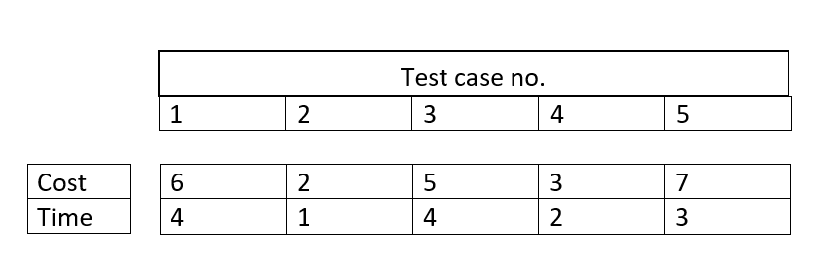
Conclusion
Test cases 1,2,4,5 is selected.
We have given the maximum time limit as 10. When we add time of test case 1,2,4,5 the total time is 10.
Our Dynamic programming in test case selection algorithm selects the test case which has minimum time and maximum cost as all test cases cannot be executed because of time limitation.

Slide 30
Complexity
The time complexity of our program is T(nrTests*tMax)

Slide 31
Thank you

